Slide 1
ELS: Data from multiple providers Coordinating the supply
Dorus Kruse
Helsinki,
2019, 23 October

Slide 2

Topics
The approach in ELF and Open ELS;
Task 3 in Open ELS: Data supply coordination;
Challenges:
Technical challenges
Governance issues
The devil is in the details
Lessons learned;
Next.

Slide 3

The approach in ELF
Cascading service;
Inspire services as is;
Showcase application only;
Data providers partner of EU funded project;
Focus on WFS’s.

Slide 4





















ELF services summary

Slide 5

The approach in Open ELS
Cascading service;
Data quality checks;
Open Data licence agreement;
No funding for providing data;
Focus on products and data needed for these products.

Slide 6

Task 3 in Open ELS: Data supply coordination and Data quality
Focus on products;
No funding for providing data;
Only accepting validated data;
Need for signed data agreements;
Budget for capacity building.

Slide 7
Cadastral Index Map
Ready and DPA signed
Some minor issues or DPA
Not open data
Prospect
Malta

Slide 8
Addresses
Ready and DPA signed
Some minor issues or DPA
Not open data
Prospect
Malta

Slide 9
Buildings
Ready and DPA signed
Some minor issues or DPA
Not open data
Prospect
Malta

Slide 10
Transport Network - Road
Ready and DPA signed
Some minor issues or DPA
Not open data
Prospect
Malta

Slide 11
Transport Network - Rail
Ready and DPA signed
Some minor issues or DPA
Not open data
Prospect
Malta

Slide 12

Challenges
Technical challenges:
ETF validation;
Capacity building;
Signed agreements;
Difficult WFS specs.
Governance issues:
No funding for providing data;
No real users or first adopters ready;
National priorities;
Architecture depending on national services and performance.
Organisational challenges:
EU Grant Agreement versus Agile development;
no sale = no data;
Partner agreement regarding deliverables, not on data.

Slide 13
Engagement status by coverage
In hands / testing
Contact later
No open data
Interest, but not priority
Expected response
Malta

Slide 14

Lessons learned
Change architecture;
Funding needed for providing data;
Agile development (involvement users);
WFS 3.0;
Compliancy with MQA, metadata DCAT-AP, multilingual;
User orientation and user requirements;
Coalition / community of the willing.

Slide 15
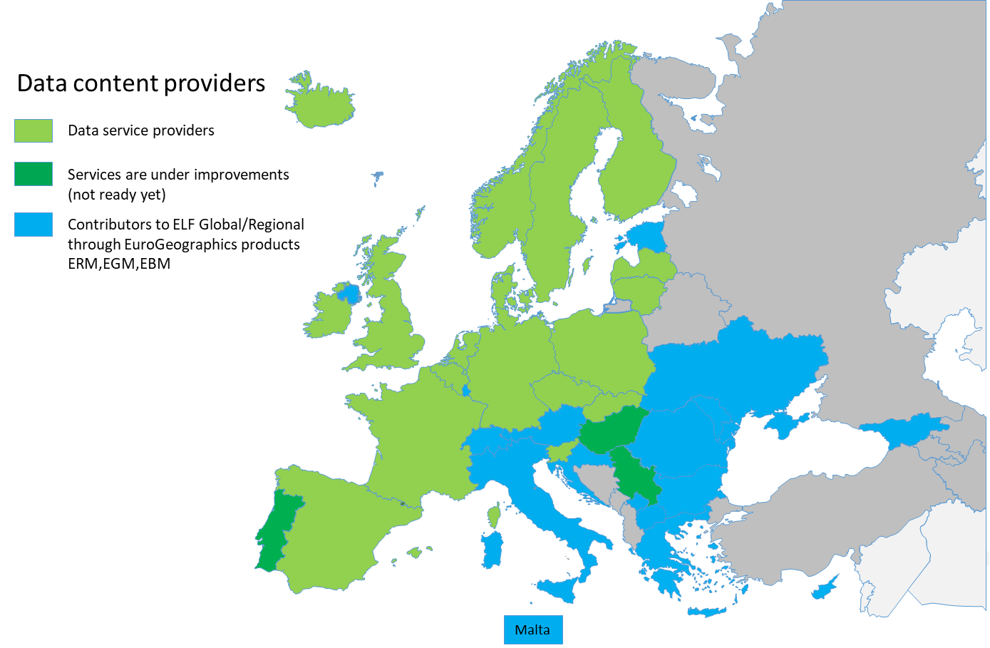
The potential coverage of Data providers in ELS

Slide 16

Next
WFS 3.0 !!
Centralised system.
Privacy and security means Authoritative data.
Coalition of the willing !!

